Slide 1
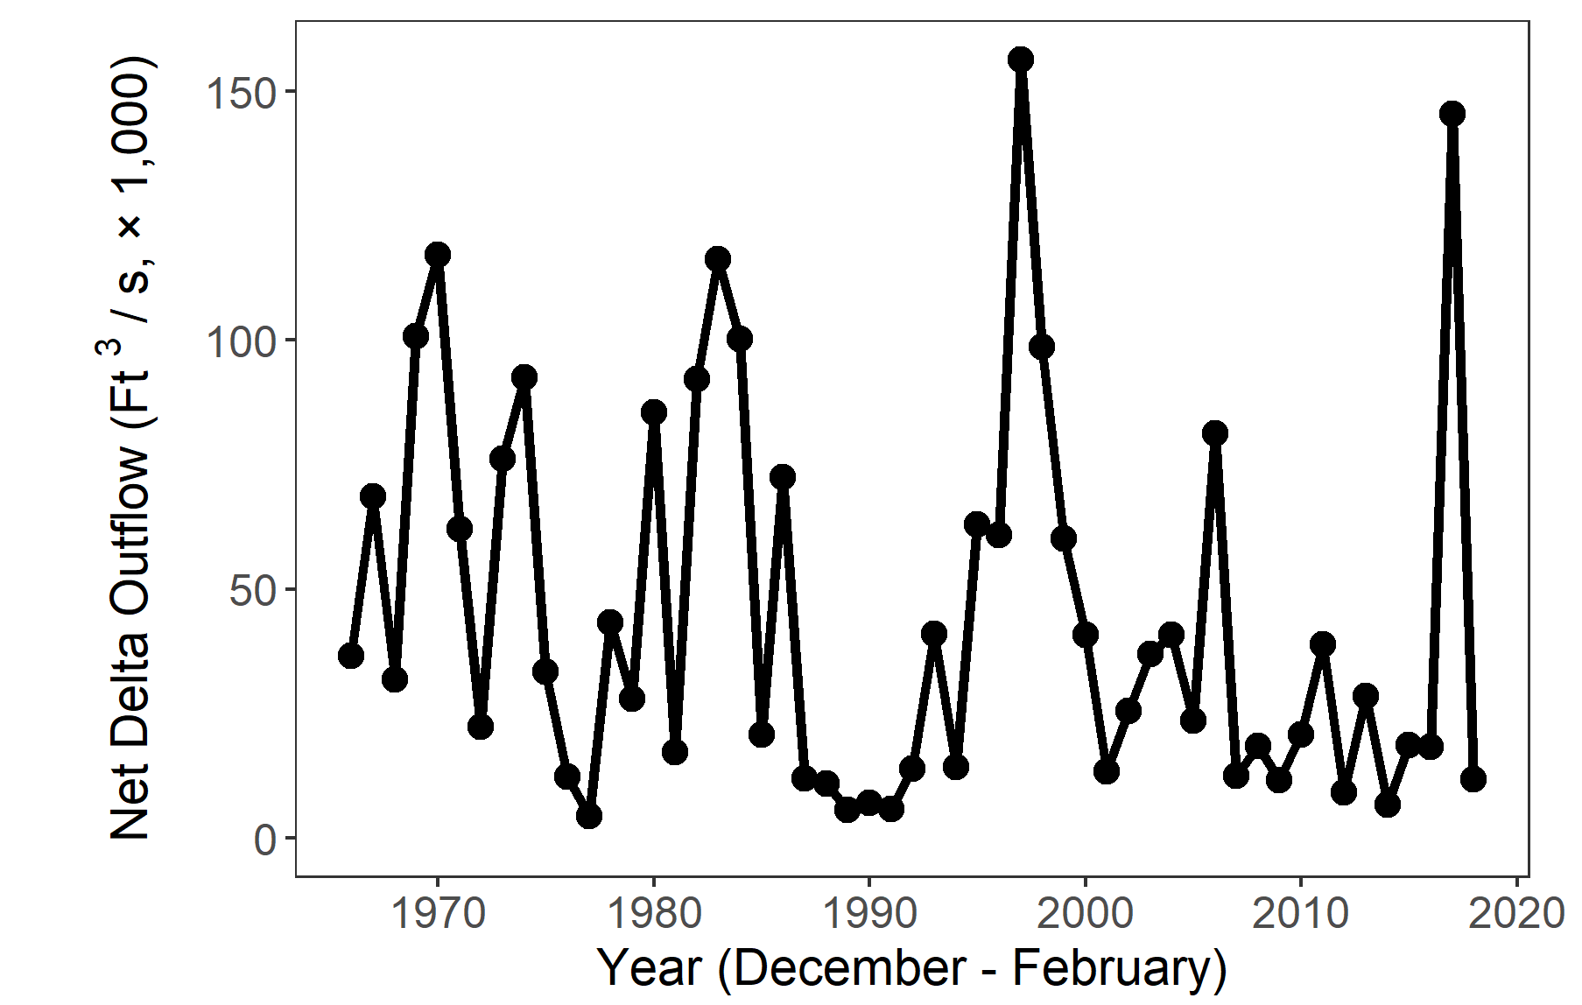
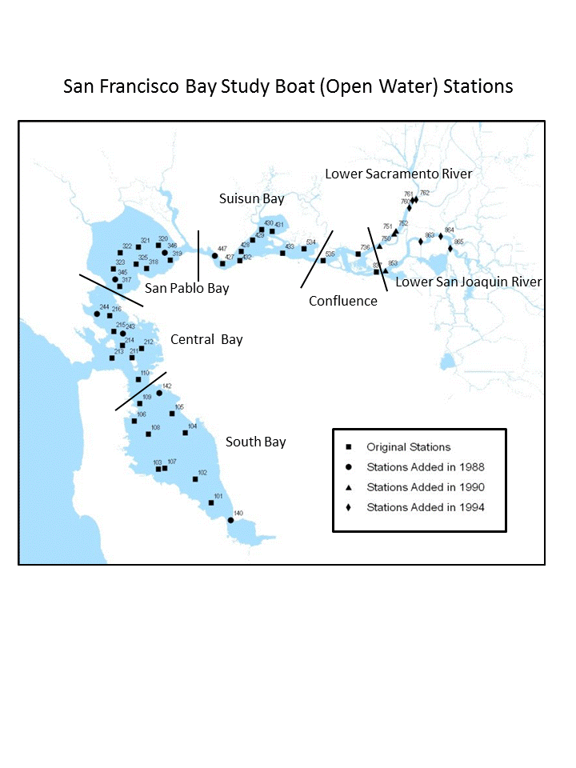
Winter 2017-2018 IEP Status and Trends Report

Slide 2
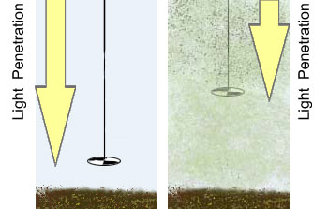
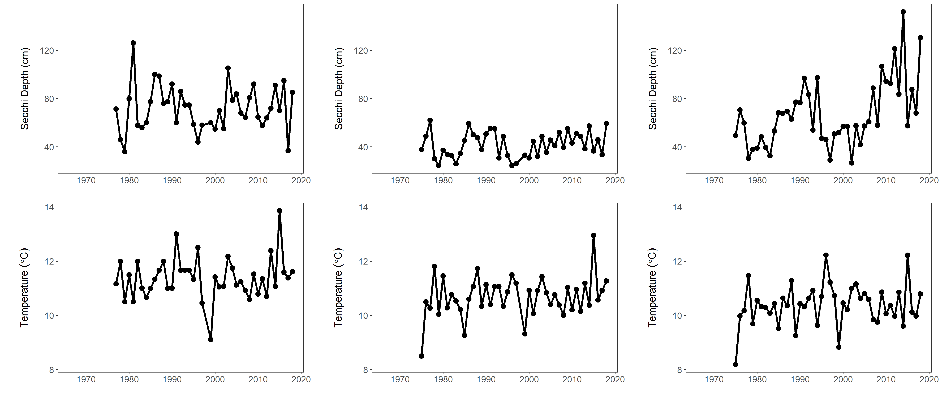
Secchi Depth
Interagency Ecological Program Status & Trends 2017-2018 Winter Season Report
Secchi disk
Organisms in this ecosystem are adapted to high turbidity conditions, and reductions in turbidity can have many negative ecological effects. Higher values for Secchi depth indicate lower turbidity.
Secchi depth is measured monthly by DWR’s Environmental monitoring program by dropping a black-and-white disk in the water until it disappears.
San Pablo Bay
Suisun Bay
The Delta
Suisun bay is usually pretty murkey, meaning low secchi depth.
San Pablo bay is pretty clear.
Suisun Bay is pretty murkey (low secchi depth)
The Delta has been getting clearer over time

Slide 3

Temperature
Interagency Ecological Program Status & Trends 2017-2018 Winter Season Report
Most fish have temperature tolerances necessary for growth and reproduction
Increasing winter temperatures may lower Delta Smelt fecundity.
Increased temperatures mean fish have to eat more.
San Pablo Bay
Suisun Bay
The Delta
Suisun bay is usually pretty murkey, meaning low secchi depth.
San Pablo Bay is slightly warmer than the Delta in the winter
Suisun Bay is usually similar to the Delta
Delta temperatures are closely linked to air temperature

Slide 4
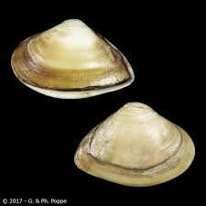
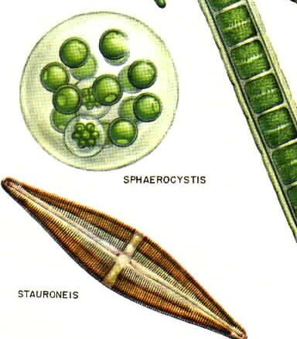
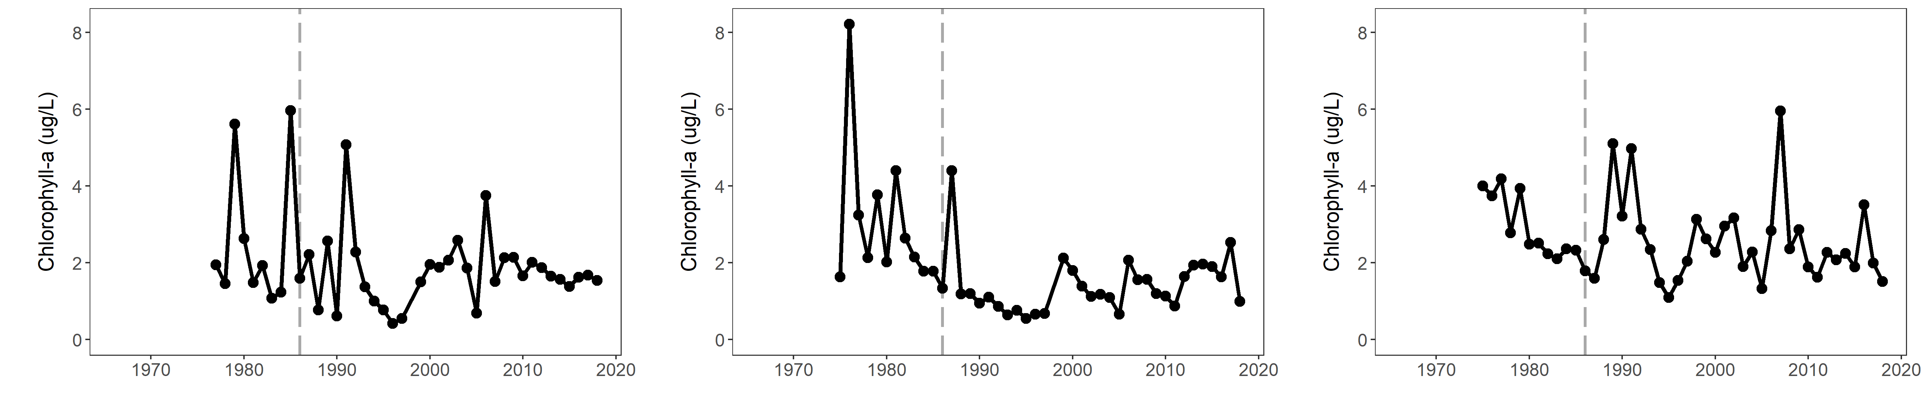
Chlorophyll
Interagency Ecological Program Status & Trends 2017-2018 Winter Season Report
Chlorophyll is an indicator of phytoplankton production, which tends to be low during the winter.
Phytoplankton are the base of the pelagic food web.
The invasive clam Potamocorbula amurensis caused a decline in phytoplankton and zooplankton – especially in Suisun Bay.
San Pablo Bay
Suisun Bay
The Delta
Winter chlorophyll has been consistently low in San Pablo Bay
The clam invasion lowered chlorophyll in Suisun more than other regions
Winter chlorophyll levels have been consistently low in the Delta

Slide 5
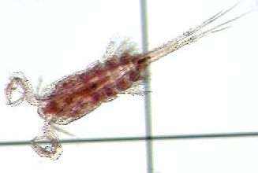
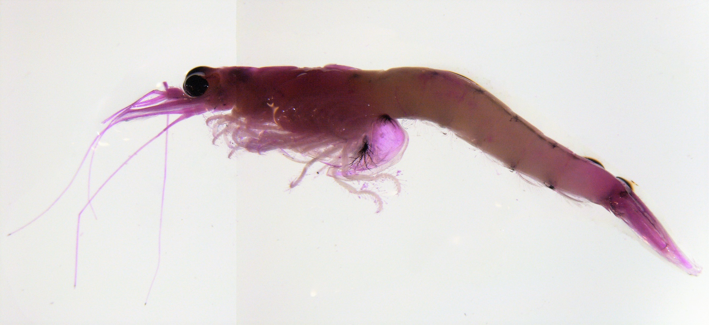
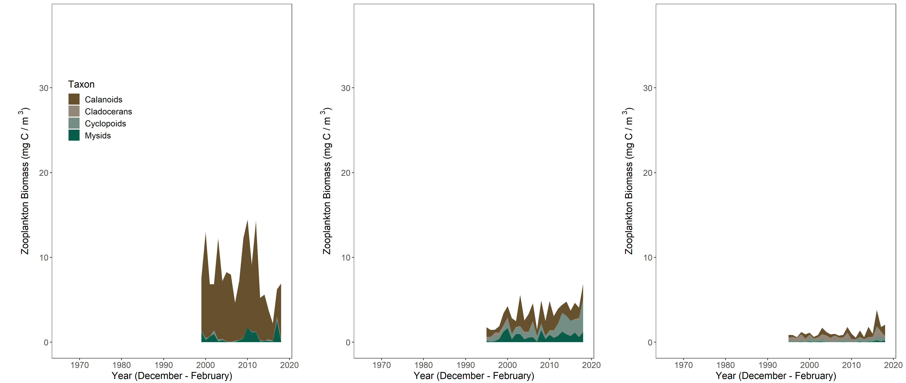
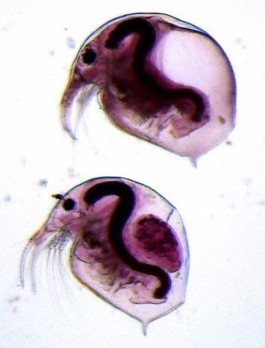
Zooplankton
Interagency Ecological Program Status & Trends 2017-2018 Winter Season Report
Zooplankton are an important food source for pelagic fish.
Biomass tends to be low in the winter.
Calanoid copepods and mysids are good fish food. Cyclopoid copepods are not as good for fish food.
San Pablo Bay
Suisun Bay
The Delta
San Pablo bay is dominated by Calanoid Copepods
Suisun has a lot of cyclopoid copepods
The Delta has low zooplankton abundance during the winter.
Notes:
Do we change the x axis so we can see it?
Also, Nick made these plots narrower and taller than the others.

Slide 6
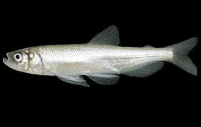
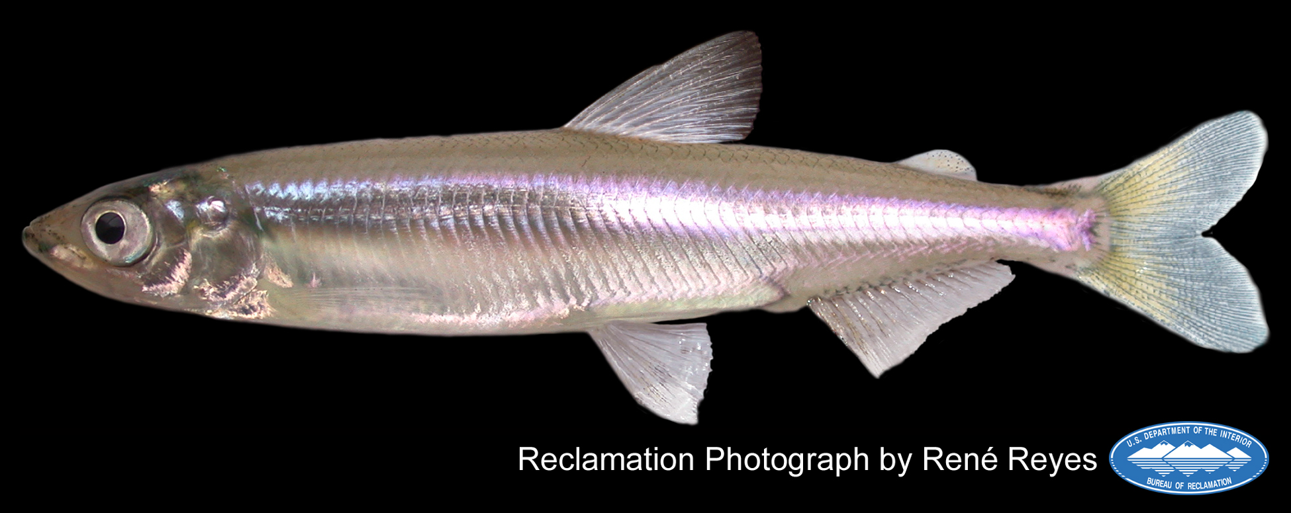
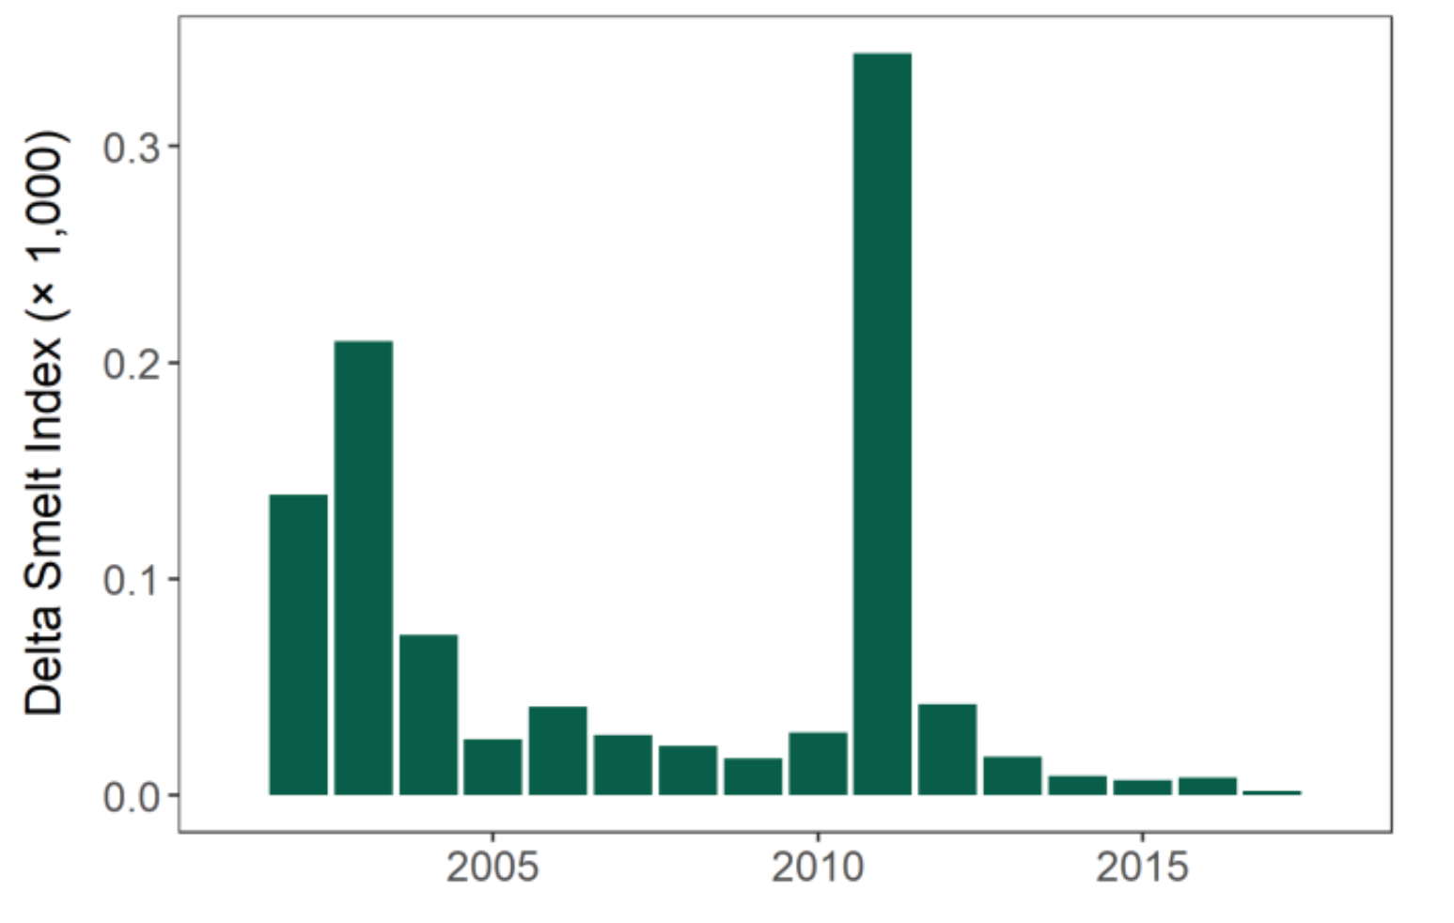
Smelt
Interagency Ecological Program Status & Trends 2017-2018 Winter Season Report
Delta Smelt is listed as Endangered, Longfin smelt is Threatened.
Delta Smelt - SKT
Longfin Smelt – Bay study
Longfin Smelt – recent trends
Spring Kodiak Trawl samples throughout the Bay and Delta.
Delta smelt have been in decline since the early 2000s
Longfin smelt experienced sever declines in the early 2000s and have not recovered.
Bay study is the only IEP survey that samples throughout San Francisco Bay, making it especially good at pickup up Longfin Smelt.
Notes:
Do we change the x axis so we can see it?
Also, Nick made these plots narrower and taller than the others.

Slide 7
Smelt
Longfin Smelt – Bay Study
Longfin smelt experienced sever declines in the early 2000s and have not recovered.
Bay study is the only IEP survey that samples throughout San Francisco Bay, making it especially good at pickup up Longfin Smelt.
Delta Smelt - SKT
Spring Kodiak Trawl samples throughout the Bay and Delta.
Delta smelt are not doing so great.

Slide 8
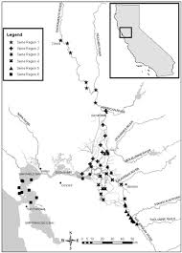
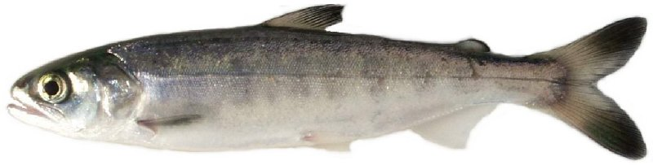
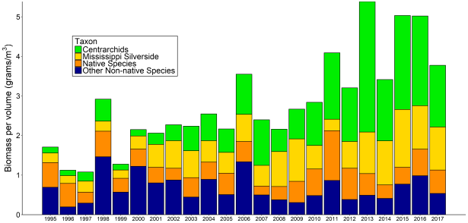
Salmon
Interagency Ecological Program Status & Trends
2017-2018 Winter Season Report
Salmon have been doing OK in recent years, though not amazing.
The drought was hard on them.
Red Bluff Diversion Dam
Preliminary estimates of passage by brood-year (BY) and run for unmarked juvenile Chinook salmon and steelhead trout captured by rotary-screw traps at Red Bluff Diversion Dam (RK391), Sacramento River, CA.
This sampling provides an estimate of production in the upper watershed.
DJFMP beach Seines
DJFMP’s beach seine data provides information on landscape patterns of juvenile chinook occurrence.
Researchers use these patterns to determine differences in salmon life-history.

Slide 9
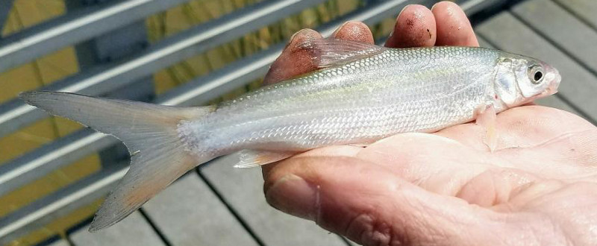
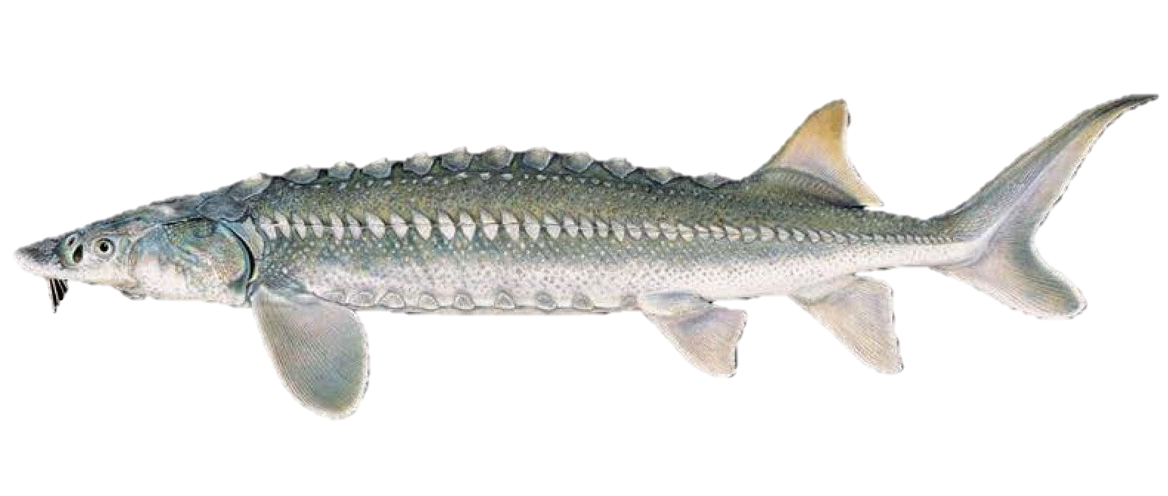
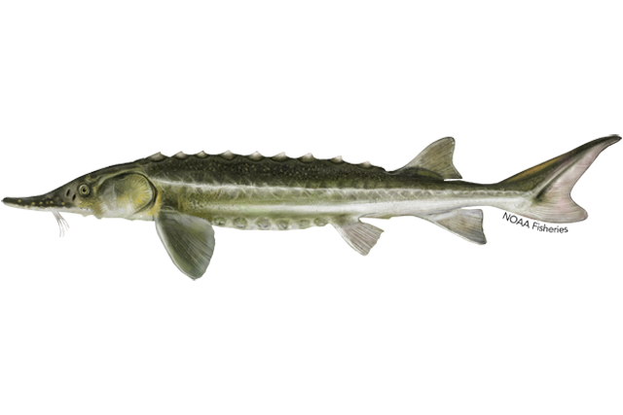
Other fish
Interagency Ecological Program Status & Trends
2017-2018 Winter Season Report
Splittail – Yolo bypass screw trap
Splittail spawn on flood plains such as the yolo bypass
They do really well in wet years.
The screw trap catches a lot of juvenile splittail in the spring after a wet year.
Sturgeon – Bay Study
Juvenile sturgeon are caught in Bay Study’s otter trawl
White sturgeon support a recreational fishery
Green sturgeon are listed as threatened.

